Slide 1
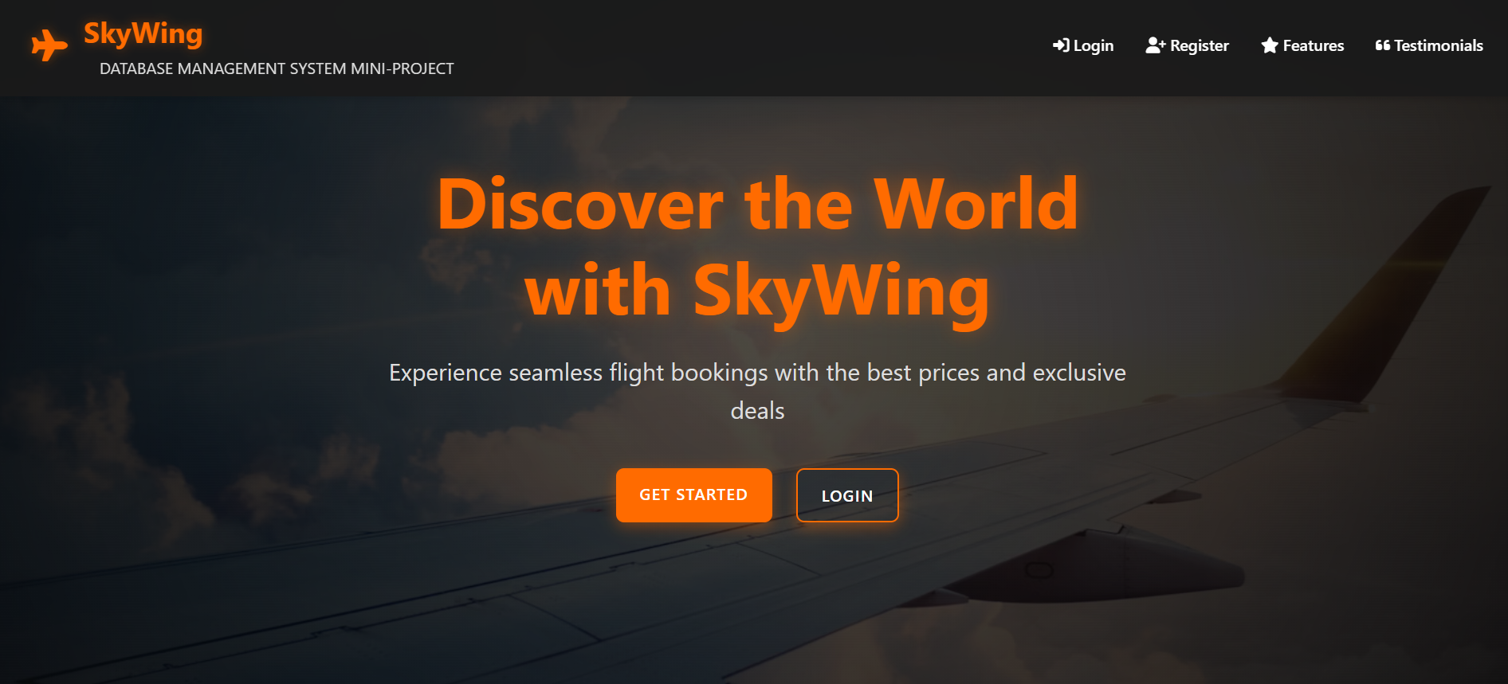
Online Flight Ticket Management System
DBMS Mini-Project Report
Submitted by: Darshan Gowda M (U25UV22T064015)
Guided by: Dr. Arunalatha J S
University of Visvesvaraya College of Engineering

Slide 2
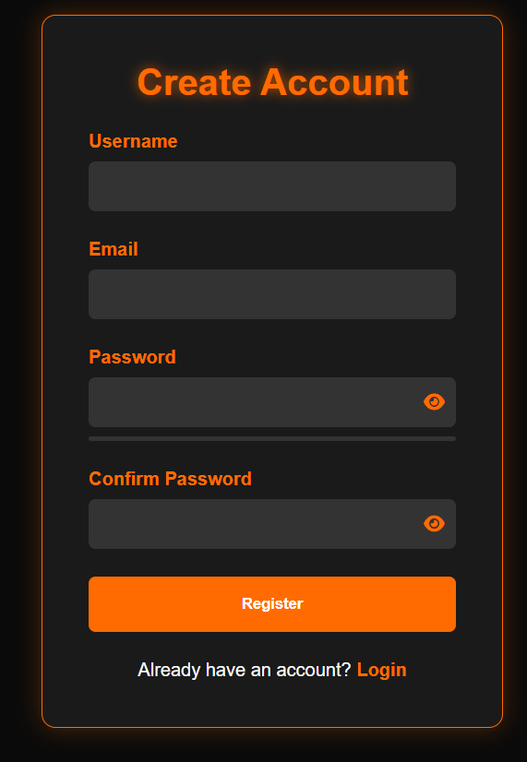



Introduction
Web-Based Application
Key Features
User authentication, role-based access, flight search, seat selection, dynamic pricing, and admin dashboard for real-time analytics
Comprehensive platform for flight booking and management with intuitive interfaces for all users
Tech Stack
Frontend built with HTML, CSS, and JavaScript; Backend powered by Node.js with Express; Database implemented in MySQL

Slide 3

Objectives
1
User-Friendly System
Develop an intuitive and easy-to-use flight ticket management system.
2
Secure Authentication
Implement secure user authentication and authorization protocols.
3
Efficient Flight Search
Enable efficient search and booking functionalities for flights.
4
Robust Database
Provide a robust database to store flight and user data securely.

Slide 4
System Objectives
For Users
For Administrators
Our system enables customers to easily book flights through an intuitive interface. Users can create and manage their profiles, apply available discounts, and access their booking history.
Administrators have comprehensive control through CRUD operations for flights, airlines, and airports. They can add new routes, update schedules, and manage seat availability.
The admin dashboard provides real-time monitoring of revenue streams, refund processing, and user activity metrics to support data-driven decision making.
The platform also facilitates dummy payment processing and handles refund requests when necessary, ensuring a smooth customer experience from search to boarding.

Slide 5
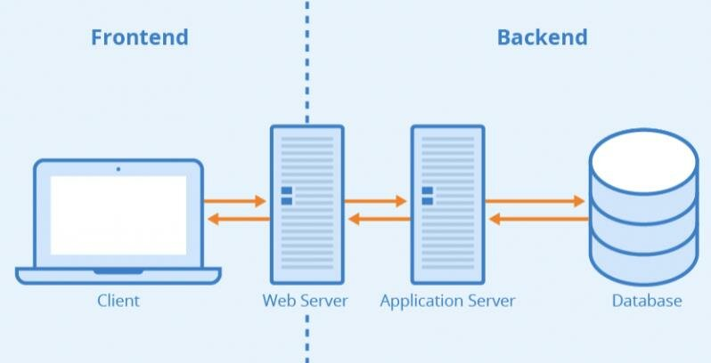




System Architecture
Frontend
User interfaces built with HTML, CSS, and JavaScript providing responsive design across devices
Backend
Node.js with Express framework handling API requests, business logic, and data validation
Database
MySQL database with 12+ tables storing all system data with optimized relationships
User Roles
Distinct access levels for Administrators and Customers with role-specific permissions

Slide 6






Entity Relationship Diagram
Core Entities
Flights, Airlines, Airports, Seats, Pricing
User Entities
Users, Passenger
Transaction Entities
Tickets, Payments, Refunds, Discounts
Our database design features carefully structured relationships between entities. Each relationship is labeled with appropriate cardinalities (1:1, 1:N, M:N) to maintain data integrity. For example, one airline can operate many flights (1:N), while a ticket is associated with exactly one flight and one user (1:1).

Slide 7
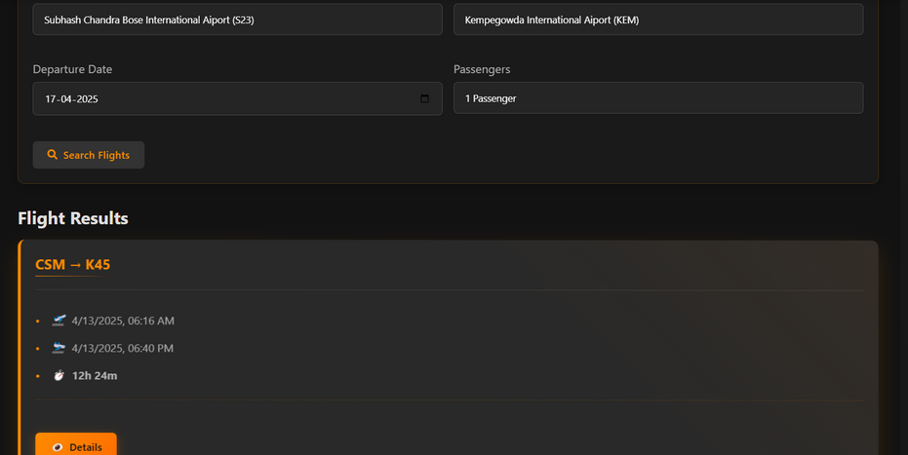
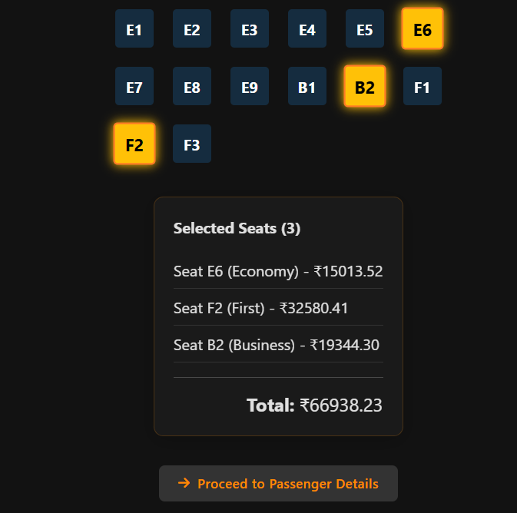
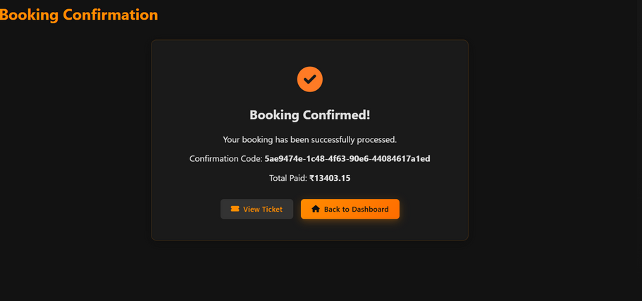
User Interface Showcase
Flight Search
Seat Selection
Booking Confirmation
Intuitive search interface with filters for dates, destinations, and price ranges
Interactive seat map with real-time availability updates and pricing tiers
Secure payment processing (dummy) and downloadable ticket generation

Slide 8
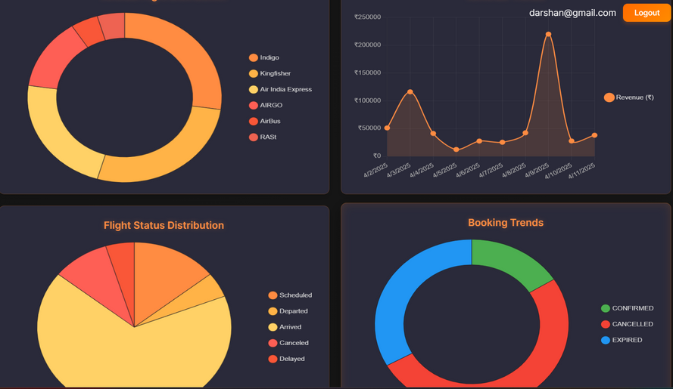
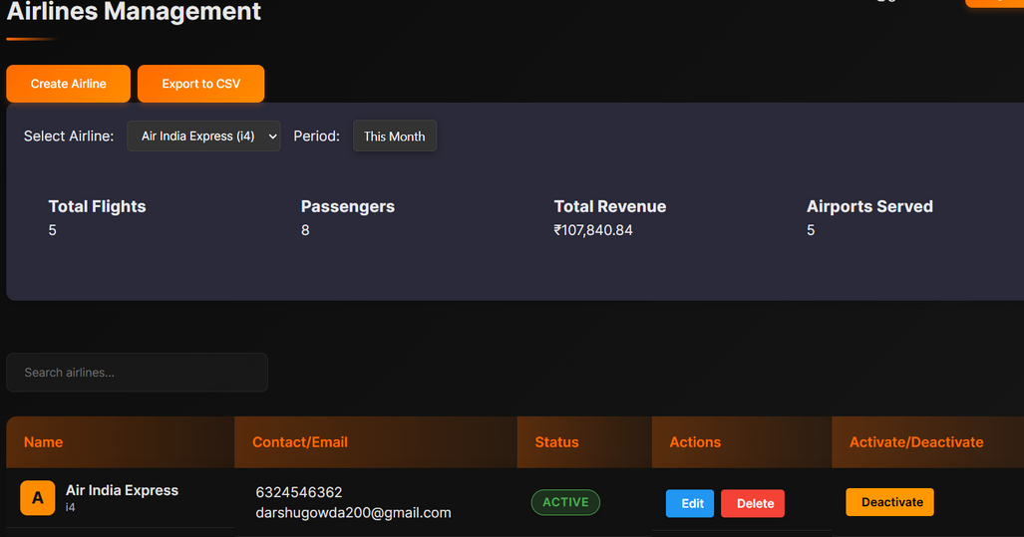
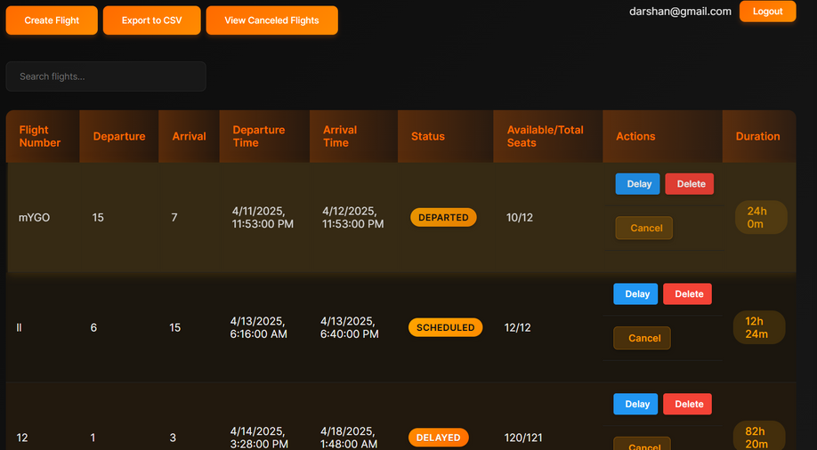
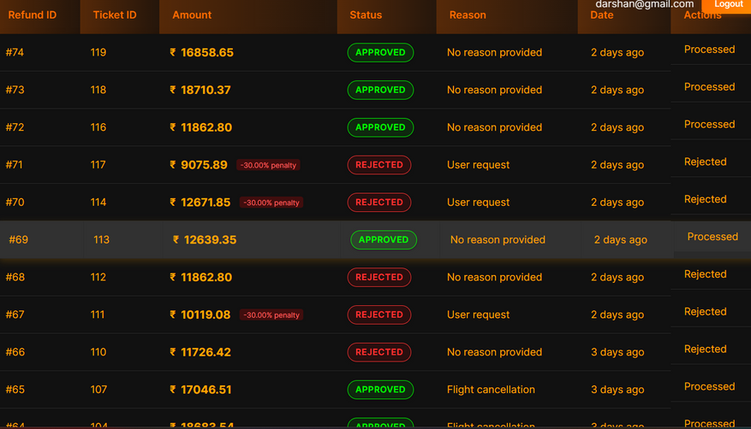
Admin Dashboard
The admin dashboard provides comprehensive management capabilities through an intuitive interface. Administrators can monitor key metrics through visual charts, manage flight schedules and pricing, manage airlines, airports, users, process refunds, and create promotional discounts. The interface is designed for efficiency, allowing quick access to all system functions.

Slide 9






Triggers & Automation
Status Updates
Auto-mark flights as "Delayed", "Departed" and "Arrived" on schedule changes based on system timings
Time Validation
Validates departure time (48-hour rule)
Dynamic Pricing
Base vs. ceiling price logic

Slide 10
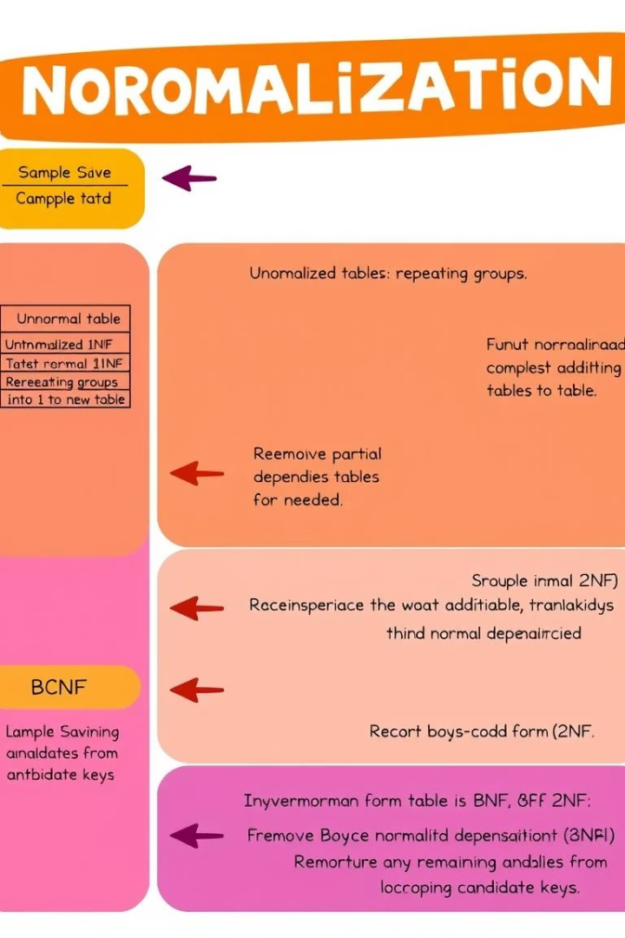
Database Normalization
First Normal Form (1NF)
Eliminated repeating groups by creating separate tables for related data. For example, passenger contact information is stored in a dedicated table rather than duplicated across bookings.
Second Normal Form (2NF)
Removed partial dependencies by ensuring that non-key attributes depend on the entire primary key. Flight schedules are separated from flight details to avoid redundancy.
Third Normal Form (3NF) to BCNF
Eliminated transitive dependencies by creating separate tables for related entities. Pricing information is stored separately from flights, allowing for dynamic pricing without duplicating flight data.

Slide 11

Advantages & Future Enhancements
Explore the benefits of our system and its roadmap for future growth.
1
Enhanced Efficiency
2
Improved Customer Experience
Streamlined booking process, reducing time and effort.
User-friendly interface with personalized booking options.
3
Future Integration
Incorporating AI for predictive travel and chatbot assistance.
OTP based authentication, etc.

Slide 12

Thank You! Click Below to go to website
SkyWing

